Slide 1
Lecture by
Decisions
Week 2
Dr Sarfraz Brohi
CSCT
October, 2023

Slide 2
Today in POP…
Introduction to selection statements
Boolean data type and Boolean expressions
One-way if statements
Two-way if-else statements
Nested if and multi-way if-else statements
Switch statements
Character and string types and operations
Case study
To do list

Slide 4
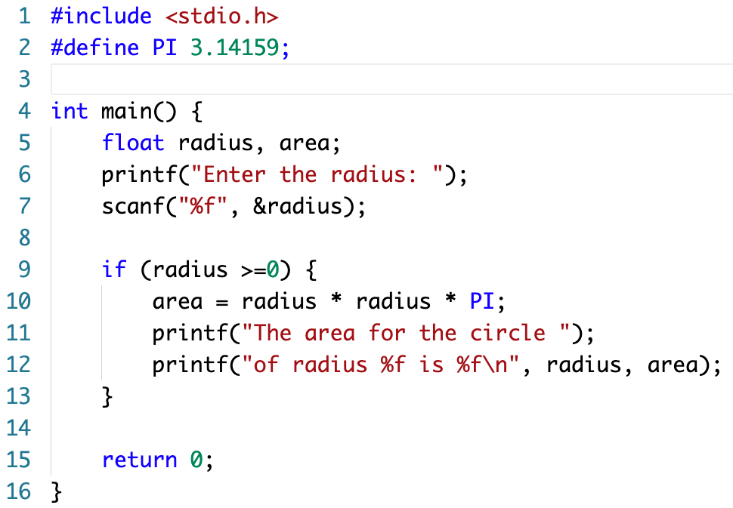
Checking Input from Keyboard
We want to use a condition to
check whether or not the input Valid.
We use a selection statement to
check the condition.

Slide 6
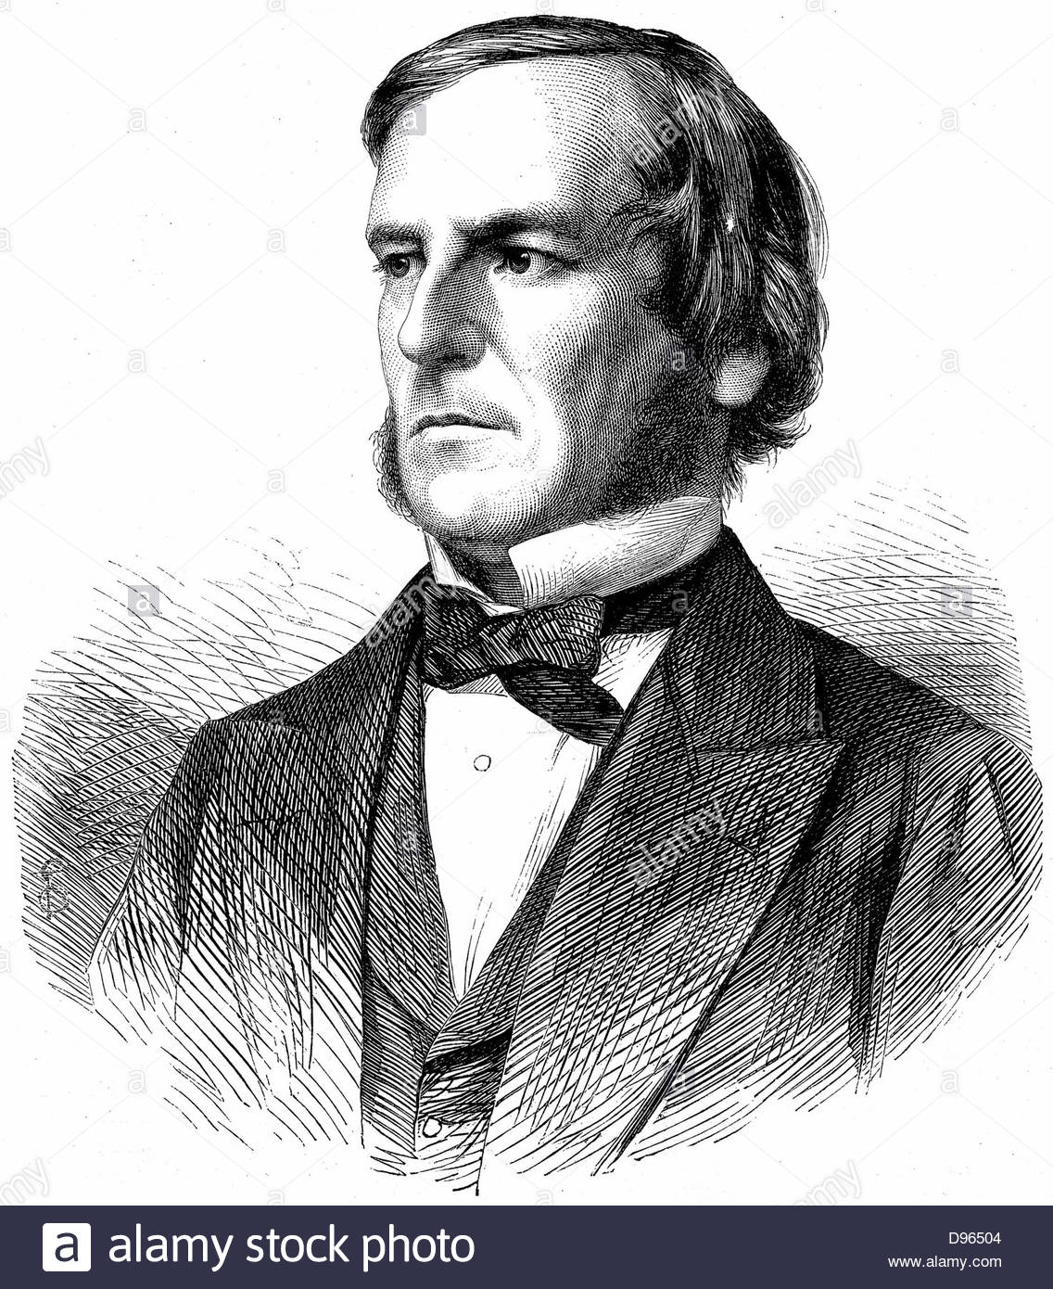
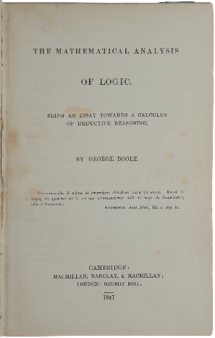
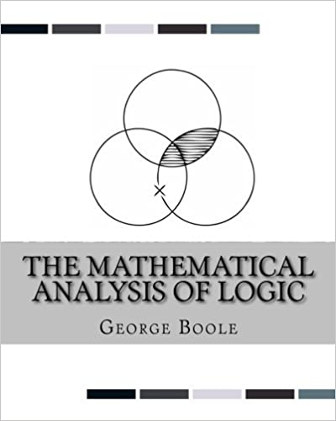
Boolean Algebra
George Boole (1815 – 1864)

Slide 7
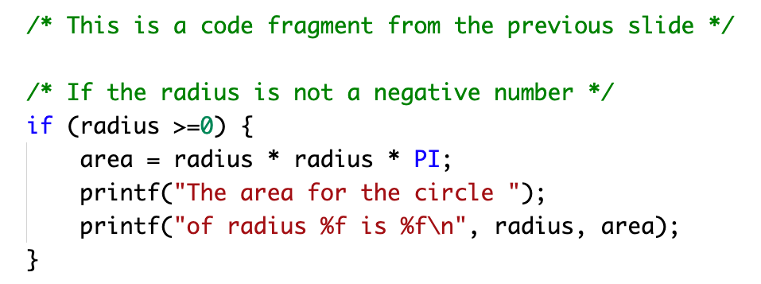
One-way if statements
A one-way if statement starts with keyword if, followed by a Boolean expression for the condition, then followed by a statement body.

Slide 8
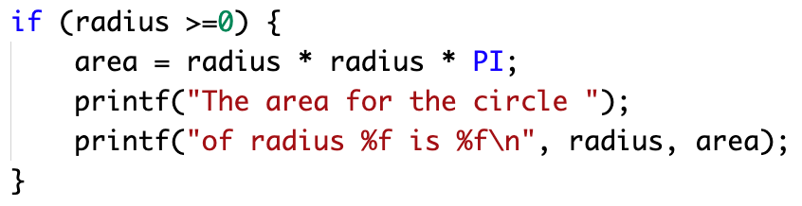
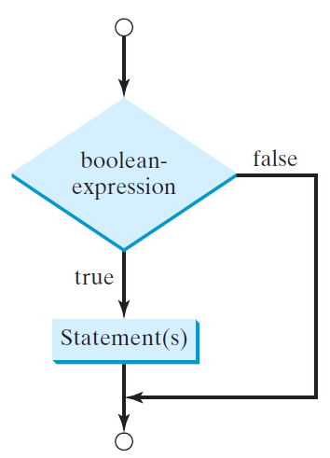
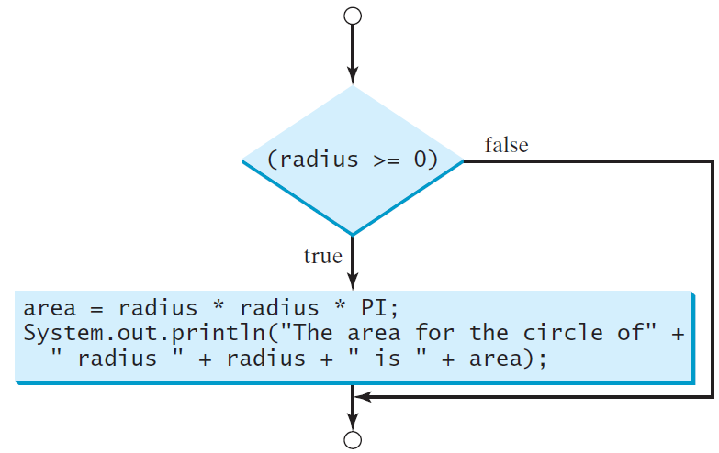
One-way if statements
if (Boolean-expression) {
statement(s);
}
area = radius * radius * PI;
printf("The area for the circle ");
printf("of radius %f is %f\n", radius, area);

Slide 9
Relational Operators
The examples are Boolean expressions. A Boolean expression consists of a variable or value on each side of a relational operator. The expression is evaluated as true if the relation operator is satisfied; otherwise it is evaluated as false.

Slide 10
Logical Operators
The examples are logical expressions. A unary logical expression consists of a logical operator, followed by a Boolean expression or value. A binary logical expression consists of a Boolean expression or value on each side of a logical operator.
NB there are also bitwise operators to perform bit level operations:
& bitwise AND, | bitwise OR, ^ bitwise XOR, ~ bitwise complement
These are beyond the scope of this lecture and not explained here.

Slide 12
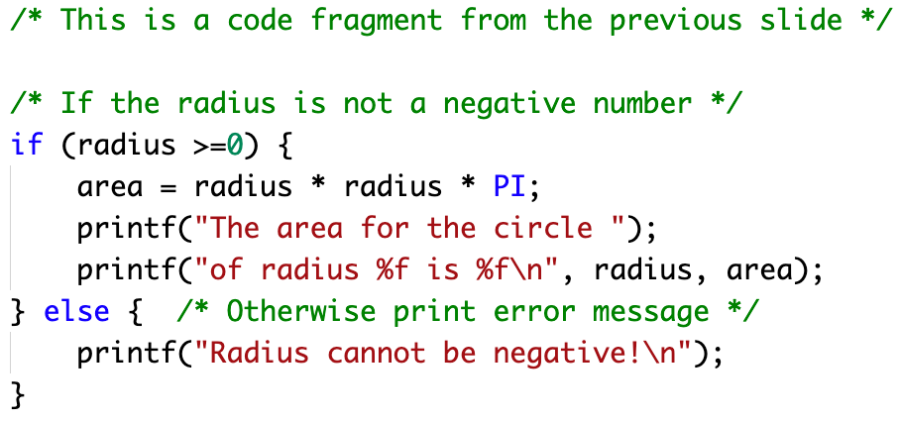
Two-way if-else statements
If there are two alternative actions to be taken, we use a two-way if-else statement: one action is taken when the Boolean expression is evaluated as true while another is taken otherwise. For each alternative action, we would need a block of statements.

Slide 13
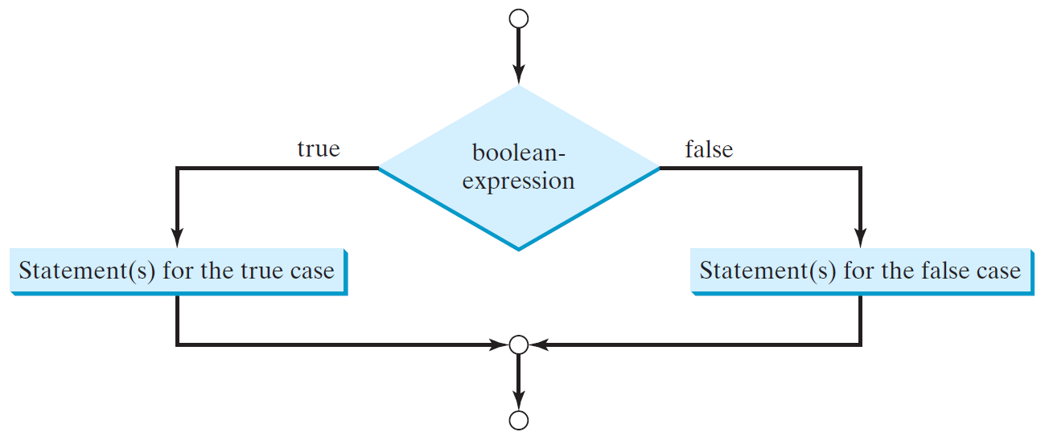
Two-way if-else statements
if (Boolean-expression) {
statement(s);
}
else {
statement(s);
}

Slide 14
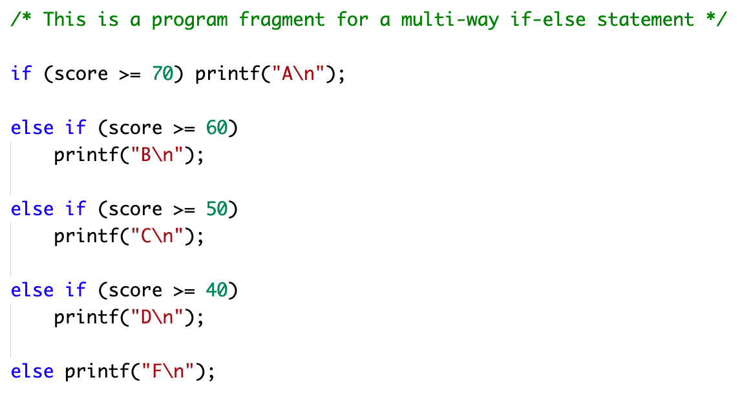
Multi-way if-else statements
This program has 4 nested if-else statements and 5 alternative actions (5 ways).

Slide 15
Multi-way if-else statements

Slide 17
switch Statements
switch (expression) {
case value1: statement(s)1;
break;
case value2: statement(s)2;
break;
…
case valueN: statement(s)N;
break;
default: statement(s)-for-default;
}

Slide 18
Example
The Chinese zodiac is based on a twelve-year cycle, with each year the cycle represented by an animal monkey, rooster, dog, pig, rat, ox, tiger, rabbit, dragon, snake, horse, or sheep, i.e., year % 12 determines the Zodiac sign.

Slide 19
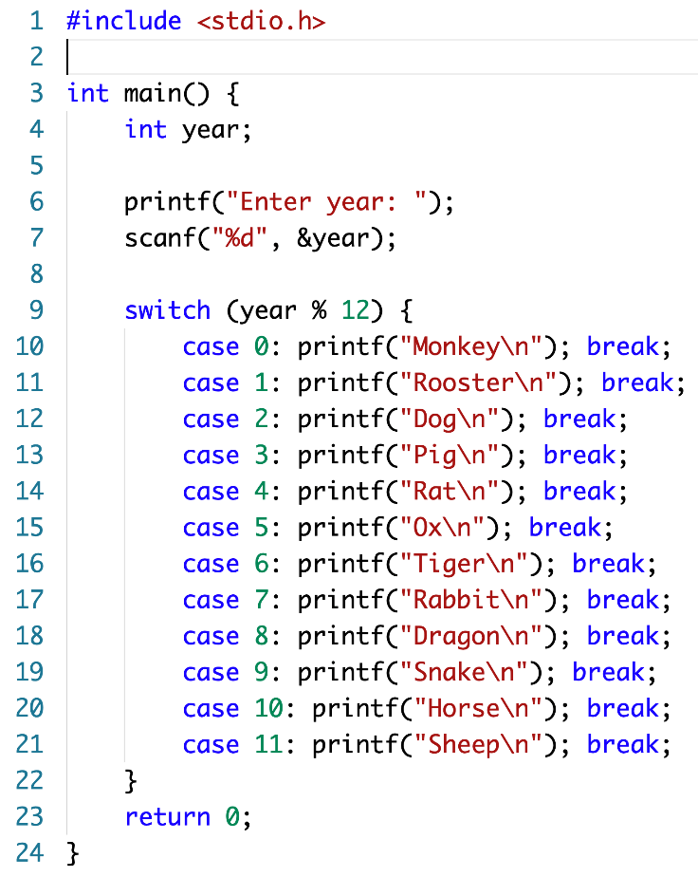
Switch Statement

Slide 21
Case Study
In this case study, we will learn how to design a solution for a given problem, and how to write a program containing a multi-way if-else statement, and how to test such a program to correctly implement the designed solution.

Slide 22
Problem Specification
The problem is to design, implement and test a program that prompts the user to enter a weight in pounds and a height in inches, calculate the Body Mass Index (BMI) and displays the health interpretation of the BMI.
The BMI is calculated by dividing the weight in kilograms by the square of the height in meters.

Slide 23
Problem Specification
For people 20 years or older BMI can be interpreted as follows:

Slide 24
Top-level Design
Prompt the user to enter a weight and a height.
Calculate the BMI.
Display the health interpretation of the BMI.

Slide 25
Design Refinement
Prompt the user to enter a weight in pounds and height in inches:
1.1 Prompt the user to enter the weight in pounds
1.2 Prompt the user to enter the height in inches

Slide 26
Design Refinement
2. Calculate the BMI:
2.1 Convert the weight in pounds into weight in kilograms with: weight in kilograms = weight * kilograms per pound
2.2 Convert the height in inches into height in meters with : height in inches = height * meters per inch
2.3 Calculate BMI : BMI = weight in kilos / (height in meters * height in meters)

Slide 27
Design Refinement
3. Display the health interpretation of the BMI:
3.1 Display the prompt of the BMI interpretation 3.2 Display the interpretation
3.2.1. If bmi < 18.5 then display "Underweight" else if bmi < 25 then "Normal"
else if bmi < 30 then display "Overweight" else "Obese"

Slide 28
Final Design
1.1. Prompt the user to enter the weight in pounds
1.2. Prompt the user to enter the height in inches
2.1. Convert the weight in pounds into weight in kilograms:
weight in kilograms = weight * kilograms per pound
2.2. Convert the height in inches into height in meters:
height in inches = height * meters per inch
2.3. Calculate the BMI:
bmi = weight in kilos /(height in meters * height in meters)
3.1. Display the prompt of the BMI interpretation
3.2.1. If bmi < 18.5 then displays "Underweight”
else if bmi < 25 then "Normal”
else if bmi < 30 then displays "Overweight”
else "Obese”

Slide 29
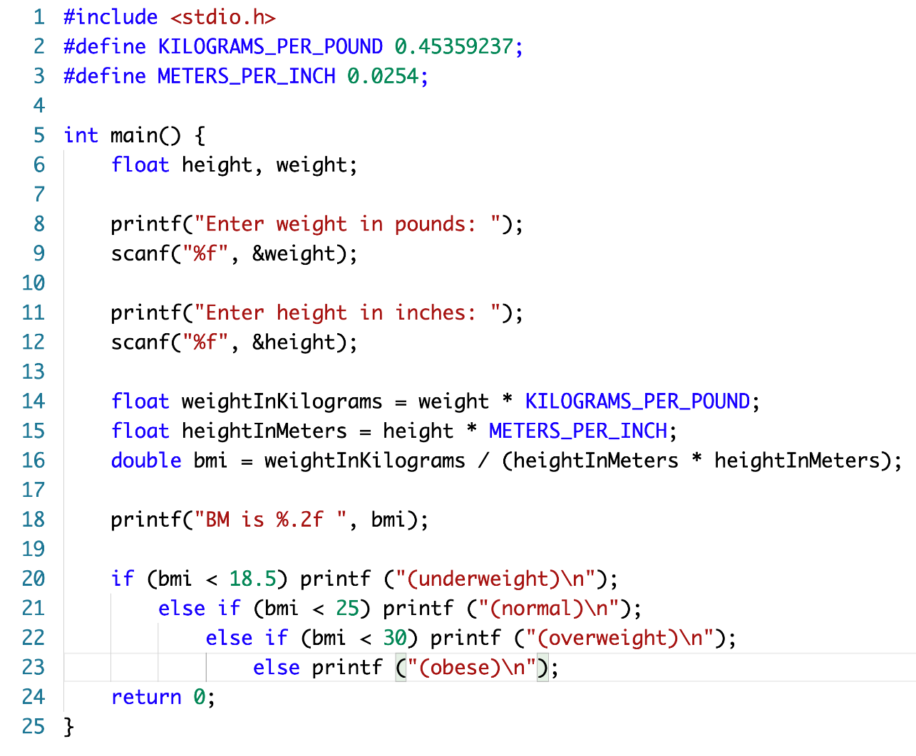
Implementation

Slide 30
Summary
Decision making (branching) in programs is based upon Boolean algebra
The if / else statement is key to implementation
Boolean and relational operators can be combined to build logical constructs
If statements can be nested, or switch can be used to choose between several boolean possibilities

Slide 31
To do before the next lecture
Read the week 2 lecture slides
Read and run week 2 examples
Selectively read those sections in Perry & Miller that cover the topics in this lecture
Attend your practical session in week 2, consisting of a tutorial, a case study and a set of programing exercise

